Slide 1



Filippos Akylas Kaloudis
EXOVIEW
AI EXOPLANET DETECTION
Page 01

Slide 2
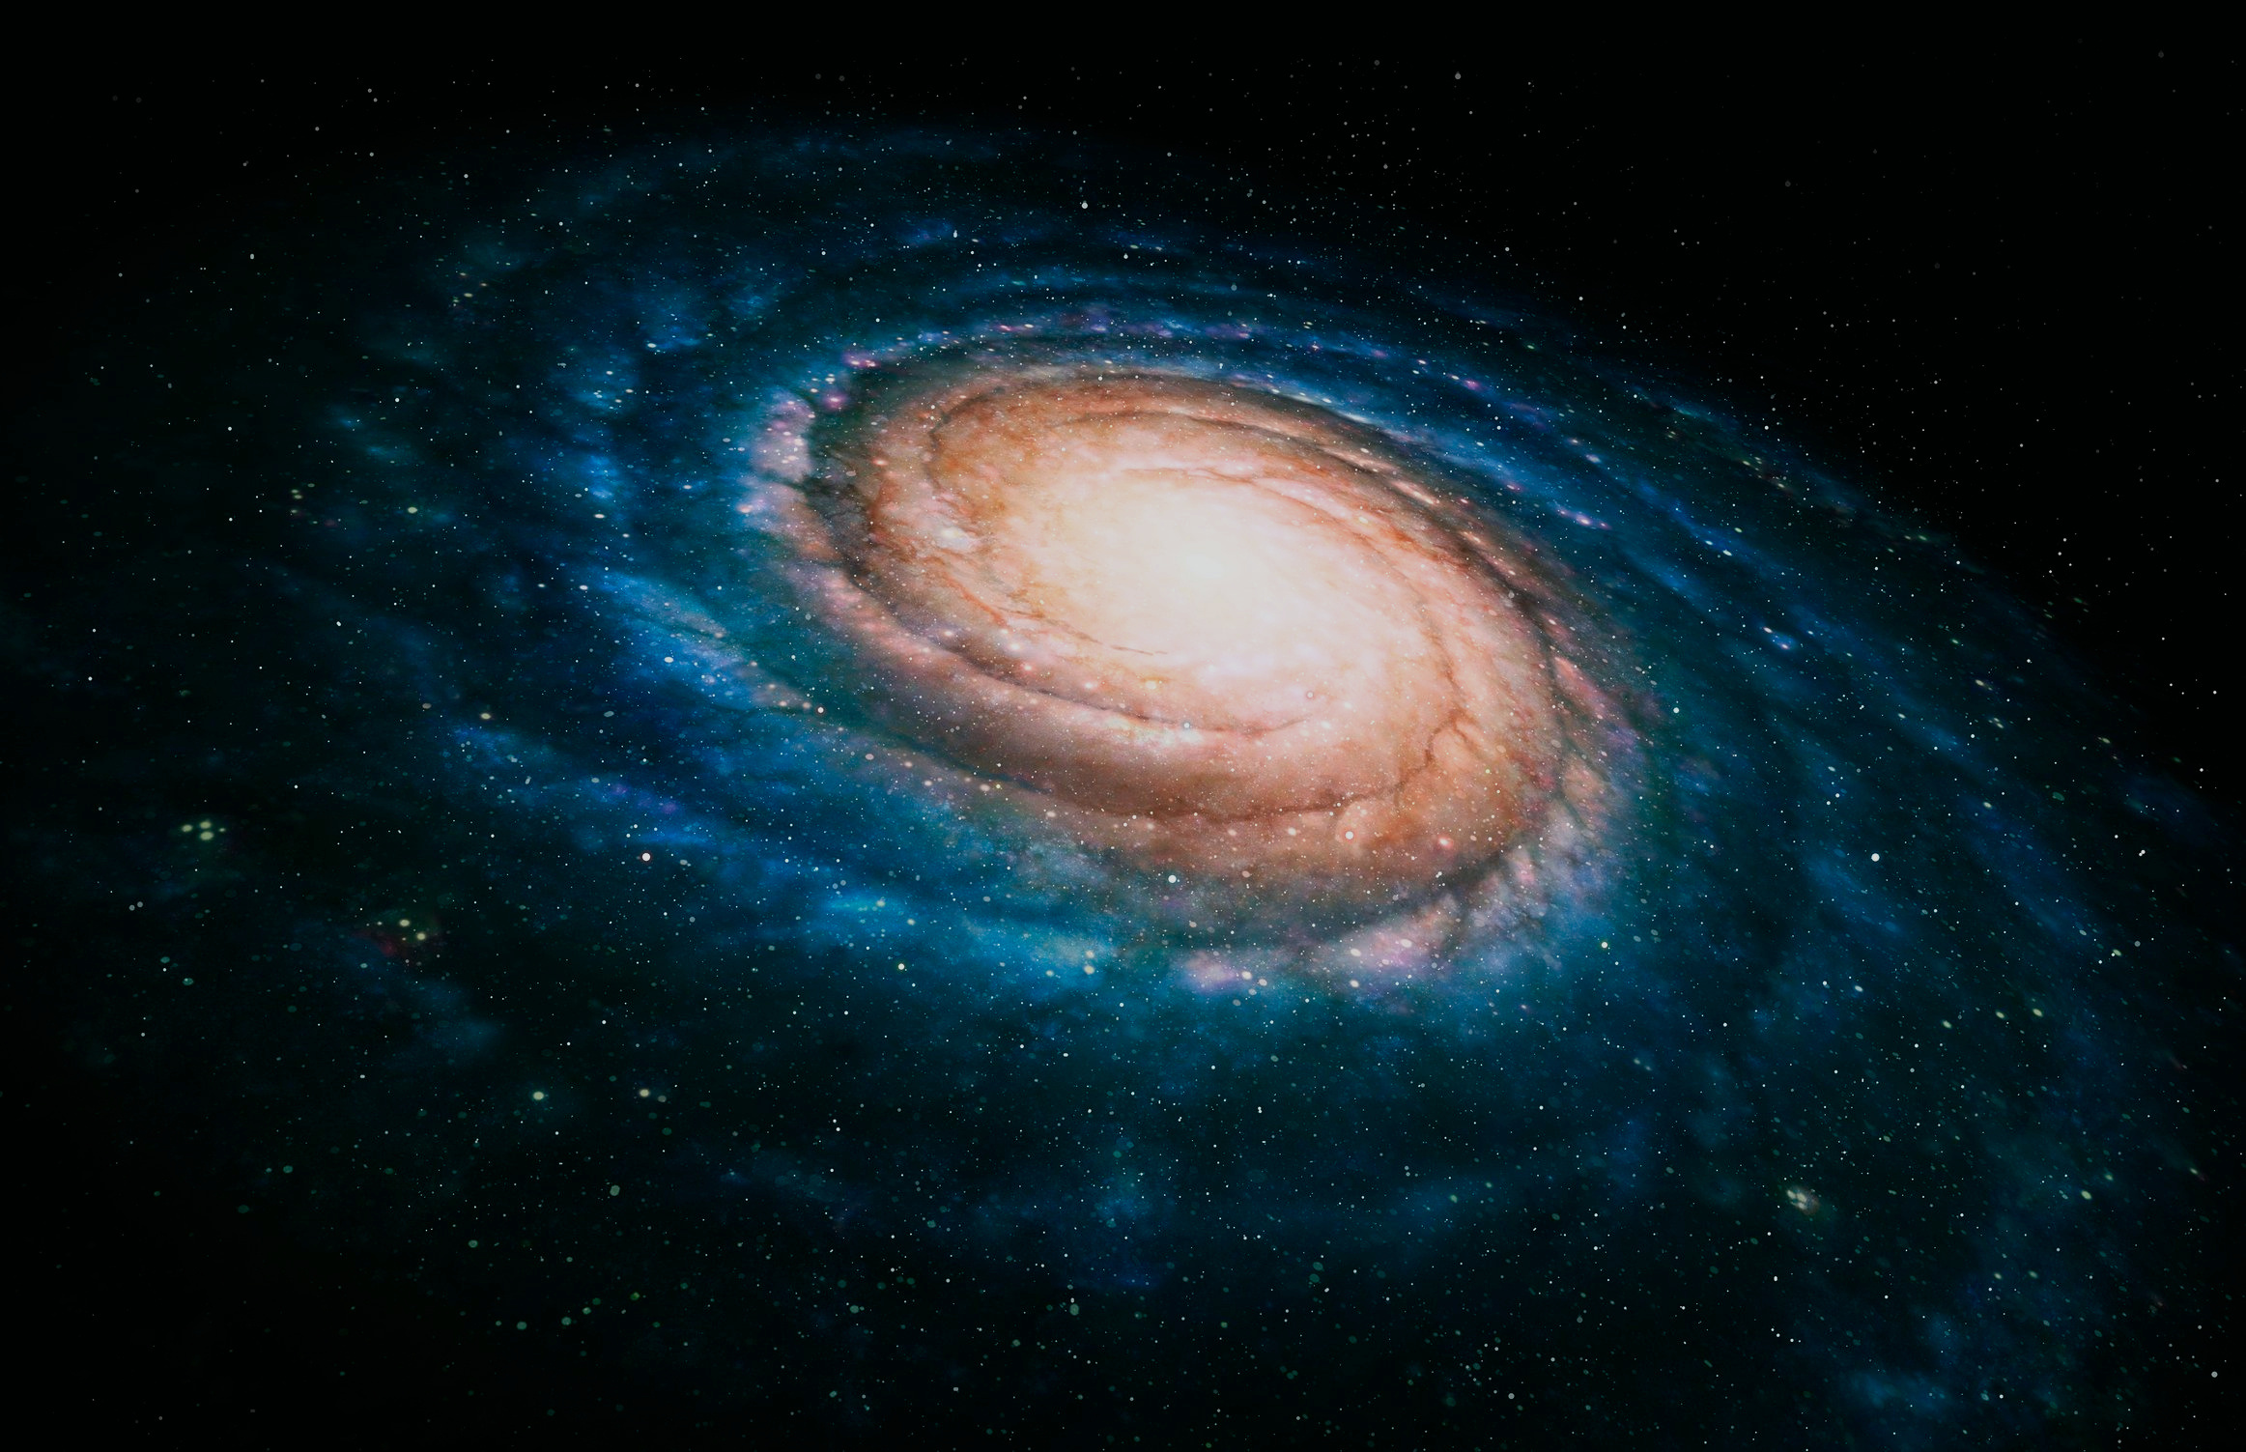
OBJECTIVE
The objective of this project is to investigate the ability of different Python machine learning algorithms (SciKit-learn) in identifying exoplanets based on orbital data of stellar bodies. This project applies and compares three different ML classification algorithms (Random Forest Classifier, K-Neighbors Classifier, Logistic Regression) to determine which model and set of hyperparameters best distinguishes exoplanets.
Page 02

Slide 3

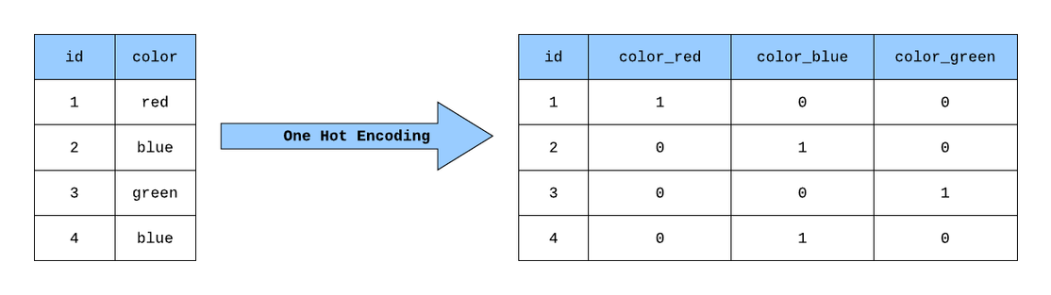
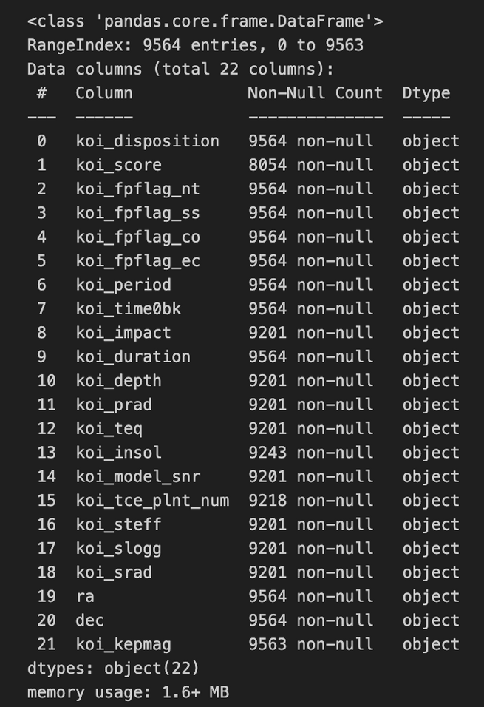
DATA EXPLORATION/CLEANING & ENCODING
The data used in this project stems from the Kepler Objects of Interest (KOI) dataset, downloaded directly from NASA’s Exoplanet Archive. Upon preliminary data exploration, we proceed with the following observations and data cleaning approaches:
Several columns have string data that is not useful to us (eg the ID of the stellar body, which is assigned). These columns are immediately dropped and not considered in our classifier.
Columns contain data in the form of python objects. These are immediately converted to float data.
Many columns contain null objects that cannot be used in our classifier. We replace them with the median of the rest of the data of the corresponding column. This process can be streamlined by using SciKit-learn’s StandardImputer
We also notice that our target (status of stellar body) is also string data. Therefore, we should encode our data for it to be used in the model. Since we have more than two possible states that are not related to each other (ie CANDIDATE is independent of CONFIRMED/REJECTED) we use One Hot Encoding. This encoder conveniently converts string data into binary arrays of 0s, 1s as illustrated in the figure below.
Figure 1: We can indicatively deduce that the precense of null data and object data types calls for data processing/cleaning
Figure 2: Illustration of One Hot Encoding
Page 03

Slide 4

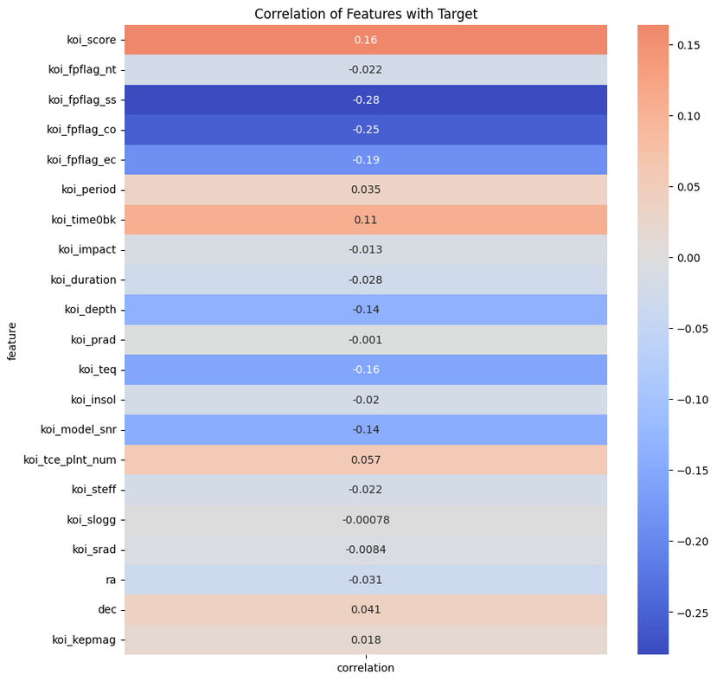
FEATURE IMPORTANCE & SCALING
Before we construct our classifier, it is important to consider the importance each feature has on the target variable. To do this, we compute the Pearson Correlation Coefficient of each feature column with the target and plot a heatmap as illustrated below.
As we can see, we can reduce the number of features used to train our models by selecting the most important ones. This will enhance the performance of our model and reduce the required training time and the computational power required to train our classifier.
Since the feature columns represent completely different physicla quantities, it is important to scale the data. We decided to use a Standard Scaler here, which relies on the standard normal distribution that centers the data by subtracting the mean (hence resulting in zero mean) and dividing by the standard deviation.
Figure 3: Heatmap showing feature importances
Page 04

Slide 5
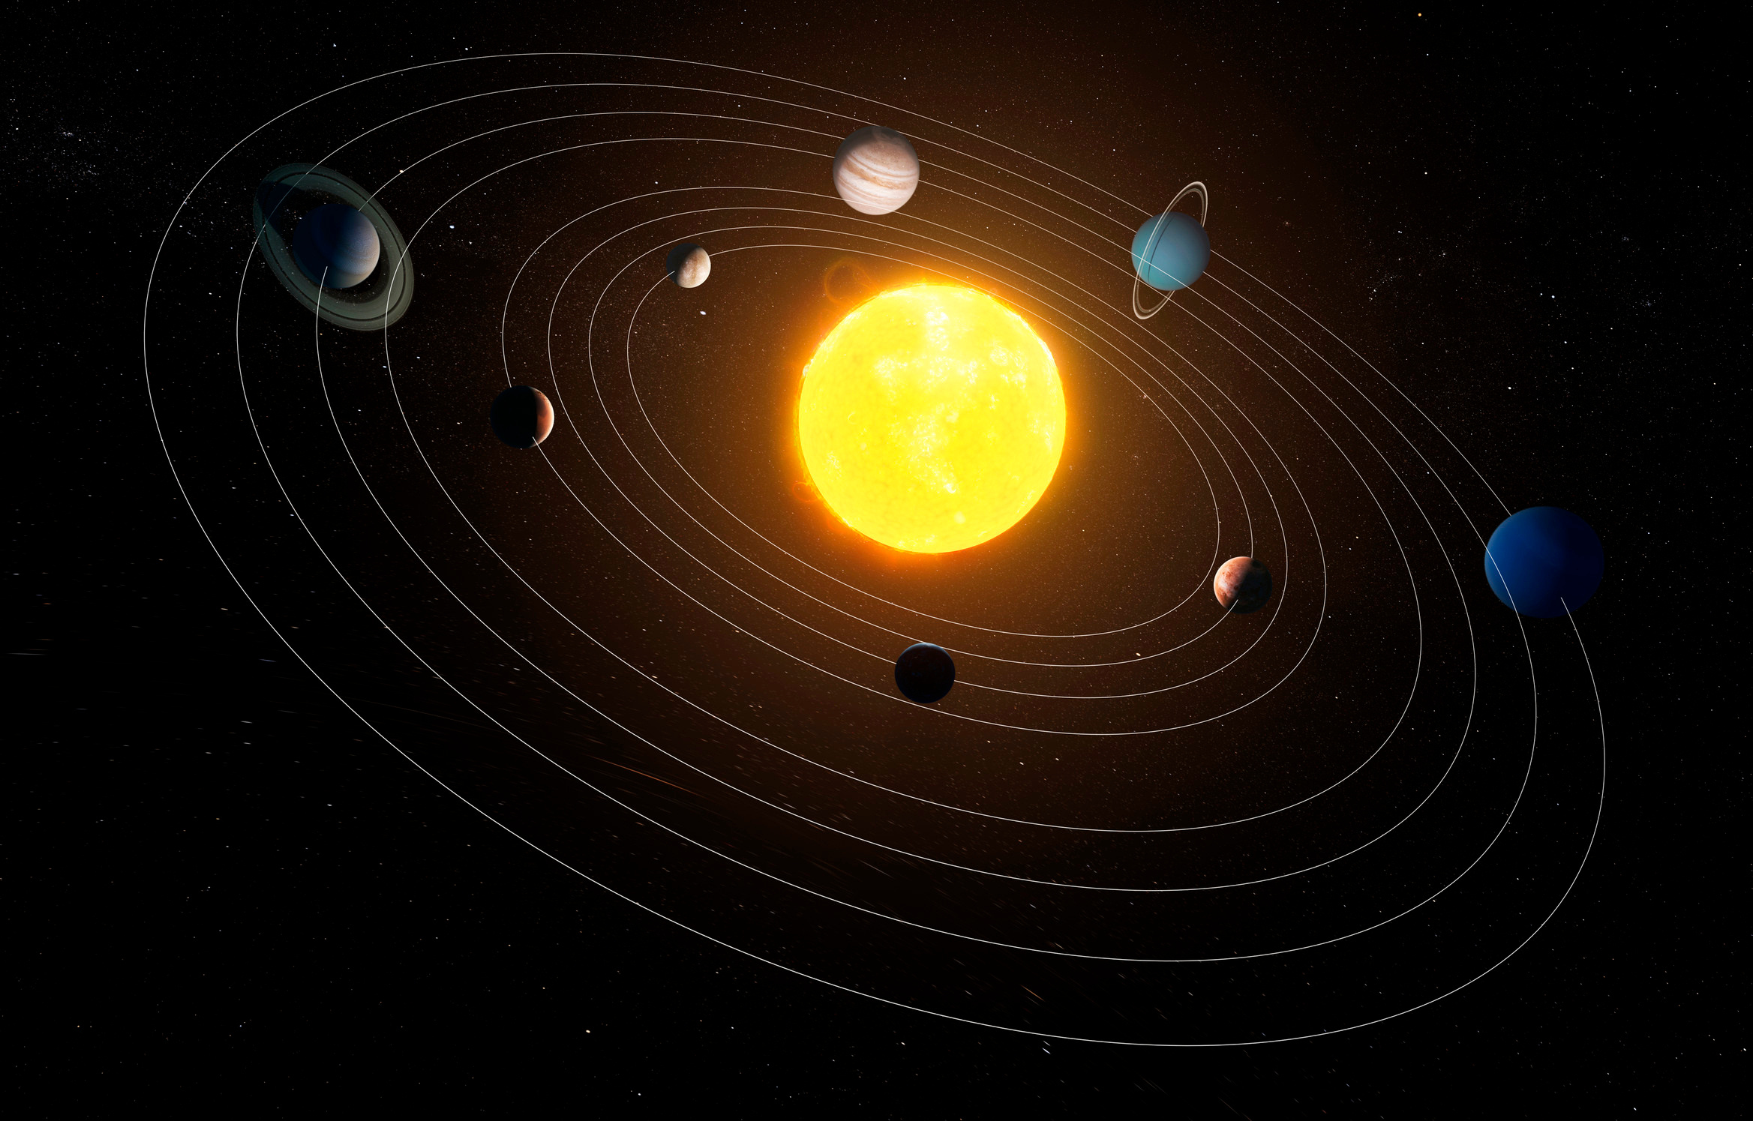
Classification models
As mentioned before, the three classifiers used in this project were a Random Forest Classifier, a K-Neighbors Classifier, and Logistic Regression (tested for binary classification by dividing the data into solely CONFIRMED and REJECTED cases). For each classifier, we carefully fine-tuned the hyperparameters using GridSearchCV and RandomizedSearchCV (best results with the formed). Additionally, we applied cross-validation by keeping a portion of the data exclusively for testing and using cross-validation (scoring was based on accuracy).
Page 05

Slide 6

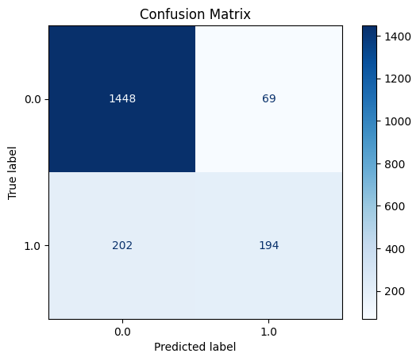
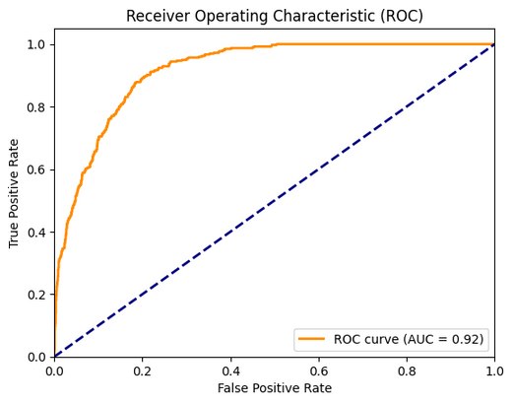
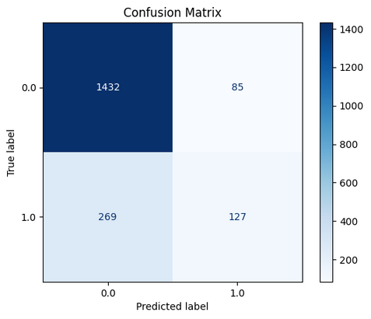
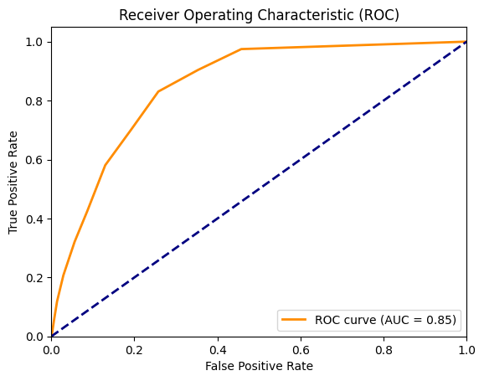
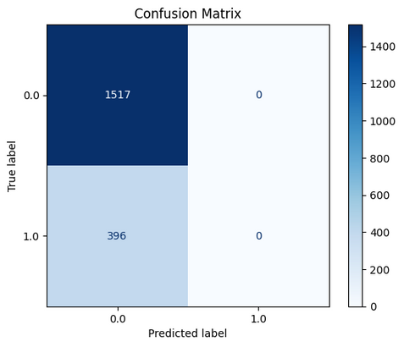
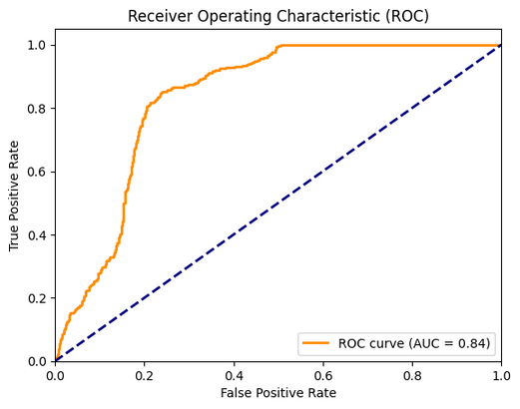
ASSESSMENT OF MODELS
To assess the different models, we plotted the confusion matrix for each case. This illustrates the number of data points that were correctly and incorrectly classified by plotting recall (y-axis) against precision (x-axis). We also plotted the Receiver Operating Characteristic Curve (ROC), which is a plot of the True-Positive Rate (TPR, y-axis) against the FalsePositive Rate (FPR, x-axis) and used the Area Under the Curve (AUC) metric to identify the best model.
Figure 4: Confusion matrix and ROC-AUC for Random Forest
Figure 5: Confusion matrix and ROC-AUC for K-Neighbors
Figure 6: Confusion matrix and ROC-AUC for Logistic Regresssion
Page 06

Slide 7
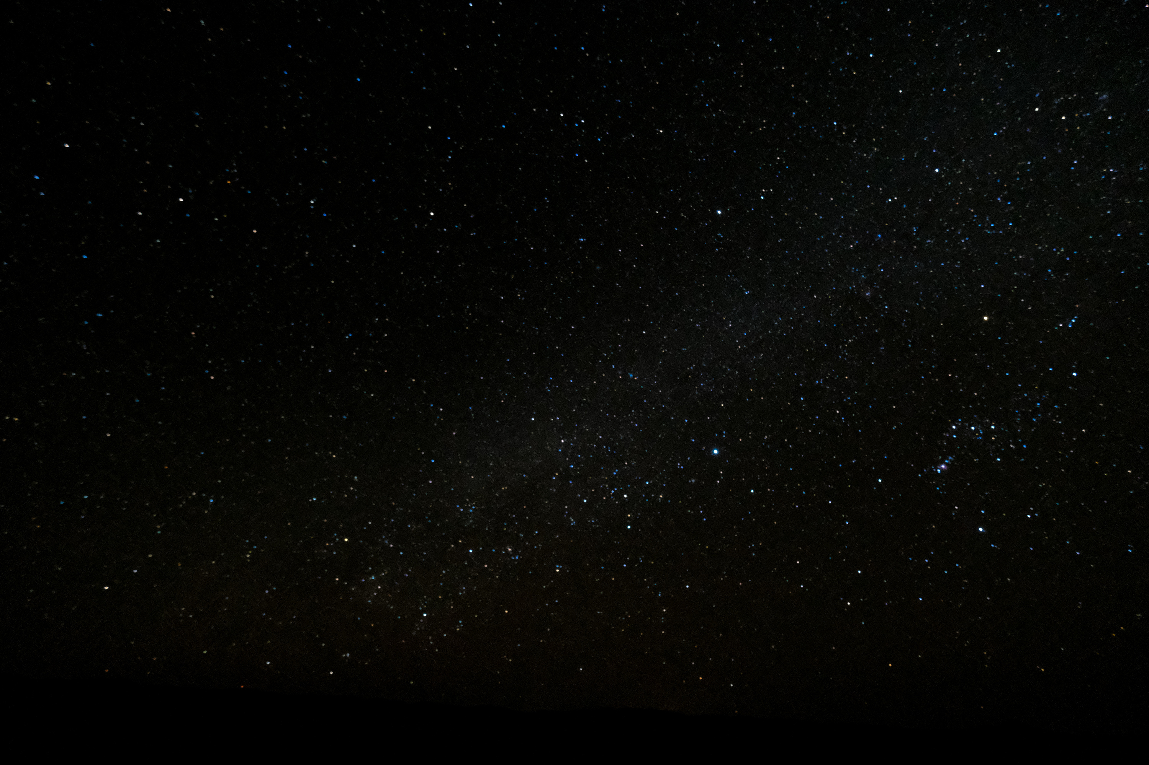
CONCLUSIONS
From the ROC-AUC graphs we can conclude that the best model for exoplanet classification is the Random Forest Classifier (fine-tuning shows that the optimal number of estimators is 100, with a max-depth of 10, yielding approximately 90% accuracy). The Logistic Regression and K-Neighbors Classifier operate very similarly, with AUC values differing within a margin of error. Interestingly enough, the confusion matrices show that Logistic Regression performs the best at accurately classifying stellar bodies as non-exoplanets, which is probably justified by the fact that is it the only binary classifier used here, meaning that everything labelled as “CANDIDATE” will be inevitably be placed as “CONFIRMED” or “REJECTED” (we could confirm this hypothesis by using a Support Vector Machine Classifier).
In the future, we could consider additional classifiers (Support Vector Machine, Decision Tree Classifier) and examine how effectively they classifiy exoplanets. Additionally, we could develop a neural network for classification to evaluate if it would enhance performance or cause overcomplications linked to overfitting/incorrect deductions.
Page 07

